Slide 1
Chapter 10
Knowledge Representation

Slide 2
Knowledge representation
Knowledge representation languages:
are the tools for helping human solve problems. As such, a representation should provide a natural framework for expressing problem solving knowledge; it should make the knowledge available to the computer and assist the programmer in its organization.

Slide 3
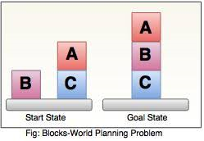
Knowledge representation
• Handle qualitative knowledge
Ex: Block arrangement can be represented by X,Y coordinates, but this is not effective method. It fails to describe and capture the properties and relations required for qualitative reasoning. An alternative method is to use predicate calculus.
clear ( c ) clear (a) ontable (a) ontable (b) on(c,b) cube(b) cube(a) pyramid (c)

Slide 4
Knowledge representation
Allow new knowledge to be inferred from a set of facts and rules.
To check whether the block is clear, that is, has nothing stacked on top of it (This is important if the robot 's hand to pick it up or stack another block on top of it. The only thing we need is a rule
For all X, X is clear if there does not exist a Y such that Y is on X
For all values of X, if no Y on X, then X is clear
∀X ¬ Ǝ Y On (Y,X) → clear (X)
Allow representation of general principles as well as specific situations.
This can be noticed in the previous example. Intelligent system must be as general as possible.
∀X∀Y Father(X,Y) → child (Y,X)

Slide 5
Knowledge representation
Capture complex semantic meaning.
It is not enough to describe a car by listing its component parts; the description must also describe the ways in which those parts are combined and the interaction between them. It is essential to a range of situations including taxonomic information, such as the classification of plants by genus and species, or description of complex objects such as a diesel engine or human body in terms of their component parts. Semantic nets is also important in describing casual relationships between events occurring over time. This is good to understand simple narrative such as a child 's story or to represent a robot 's plan of actions.
hassize(bluebird,small)
hascovering(bird,feathers)
hascolor(bluebird,blue)
hasproperty(bird,flies)
isa(bluebird,bird)
isa(bird,vertebrate)

Slide 6
Propositional Calculus
Some of the well-known knowledge representation tools are:
* Propositional calculus * Predicate calculus * Semantic network * Fame-based structure * Conceptual graphs *Ontology *Scripts
Propositional Calculus
It is the first language /tool used for knowledge representation
Propositional calculus symbols
P,Q,R,S,T, …
Truth symbols
True, false
Connectives
Ʌ , V, = , and , or , ~ , → (implies)
For A → B, we say if A is true then B is true, if A is false, nothing is said about B.
propositional symbols denote propositions, or statements about the world that may be either true or false, such as " the car is red" or " water is wet"

Slide 7
Propositional Calculus
Propositional calculus sentences
Every propositional symbol and truth symbol is a sentence. Any combination between two sentences using connectives is a sentence.
P and Q , P or ~ P , P → Q (T → F gives F otherwise true) –
((P and Q ) → R) = ~P or ~Q or R
(P or Q) = R not equal P or (Q=R).
Refer to all the related laws of propositional calculus in the lecture notes.
~ (~ P) = P
(P V Q) = (~ P → Q)
~ (P V Q) = (~ P Ʌ ~ Q)
~ (P Ʌ Q) = (~ P V ~ Q)
(P Ʌ Q) = (Q Ʌ P) and ( P V Q) = (Q V P)
((P Ʌ Q) Ʌ R) = (P Ʌ (Q Ʌ R)) Associative law
((P V Q) V R) = (P V (Q V R))
P V (Q Ʌ R) = (P V Q) Ʌ (P V R) Distributive law
P Ʌ (Q V R) = (P Ʌ Q) V (P Ʌ R)
(P → Q) = (~ Q → ~ P) Contra positive law

Slide 8
Predicate Calculus
Predicate Calculus
Using propositional logic, we can write a sentence " It rained on Tuesday". How to say that for every day in the week ? We can create a predicate weather that describes a relationship between a date and the weather :
weather (Tuesday, rain). We can write weather(X,rain) for all the days of the week.
The alphabet
The set of letters (upper and lower).
The set of digits 0,1,…,9.
The underscore
Constants must begin with lower letter (e.g. ali , cat, …..)
Variables must begin with upper letter (e.g., X, Y, X_name, ……)
A function expression is a function symbol (starts with small letter) followed by its arguments.
(e.g., f(X,Y) , plus(3,5) , all are well formed function expression).
Symbols and Terms
It includes
Truth symbols true and false.
Constant symbols.
Variable symbols.
Function symbols.

Slide 9
Predicate Calculus
Atomic sentence in predicate calculus is a predicate of arity n followed by n terms closed in parentheses separated by commas.
likes(ali,milk).
likes(ali,moh'd,milk).
friends(ali,kamal).
friends (father(ali),father(mohd)).
john:-father(ali).
kammal:- father(mohd).
Any combinations between sentences using connectives is a sentence.
In predicate calculus we use two main quantifiers for all values ∀ and there exist Ǝ
All people like ice-cream ∀X likes(X,ice_cream).
At least there is one friend for peter.
ƎY friends(Y, peter).
If X is a variable and S is a sentence then ∀X S is sentence.
ƎX S is a sentence.

Slide 10
Predicate Calculus
Notes:
~ ƎX p(X) = ∀X ~p(X)
~ ∀X p(X) = ƎX ~ p(X)
ƎX p(X) = ƎY p(Y)
∀X q(X) = ∀Y q(Y)
∀X (p(X) and q(X)) = ∀X p(X) and ∀Y q(Y)
ƎX (p(X) or q(X)) = ƎX p(X) or ƎY q(Y)
Ex.
All basketball players are tall
∀X (basketball-player(X) → tall(X))
If it does not rain tomorrow, Tom will go to mounting
~ weather (rain,tomorrow) → go(tom,mountain)
Some people like reading
ƎX (person(X) and likes (X,reading))
If day is Friday, It is holiday
∀X (Equal (X, Friday) → holiday(X))

Slide 11
Theorem Proving
Example on theorem proving in predicate calculus
Marcus was a man.
man(Marcus)
Marcus was a Pompeian
pompeian(Marcus)
All Pompeians were Romans
∀X pompeian (X) → roman (X)
Caesar was a ruler.
ruler (Ceasar)
All Romans were either loyal to Caesar or hated him.
∀X (roman(X) → ((loyalto (X,caesar) v hate(X,caesar)) ^ ~ (loyalto(X,caesar) ^ hate(X,caesar))
Everyone is loyal to some one.
∀X ƎY loyalto(X,Y)
People only try to assassinate rulers they are not loyal to.
∀X ∀Y person(X) ^ ruler(Y) ^ tryassassinate (X,Y) → ~ loyalto (X,Y)
Marcus tried to assassinate Caesar .
tryassassinate (marcus,caesar)
The goal is Was Marcus loyal to Caesar.
loyalto(marcus,caesar)

Slide 12
Theorem Proving
since loyalto as a goal is not available, we try to work with not loyalto which is available.

Slide 13
Theorem Proving
In our case, we know that there is a missing knowledge. If we add
9. All men are people
∀X man(X) → person(X)
We continue the proving process
this proves that Marcus is not loyal to Caesar.

Slide 14
Theorem Proving
Example
1. Marcus was a man
man(marcus)
2. Marcus was a Pompeian.
pompeian (marcus)
3. Marcus was born in 40 A.D.
born(marcus,40)
4. All men are mortal
∀X man(X) mortal (X)
5. All pompeians died when the volcano erupted in 79 AD.
erupted(volcano,79) Ʌ ∀X (pompeian (X) died (X,79))
5a) erupted(volcano,79)
5b) ∀X (pompeian (X) died (X,79))
6. No mortal lives longer than 150 years. (is the person dead in the given date t2)
Is the person dead in 2023? 2024 is t2
Assume the birth year is 1860, t2-t1 = 162 > 150
∀X ∀t1 ∀t2 mortal(X) Ʌ born (X,t1) Ʌ gt(t2-t1,150) dead (X,t2)
7. It is now 2025
Now= 2025
Is Marcus alive? alive(marcus, now)

Slide 15
Theorem Proving
We add additional knowledge. For example, our statements talk about dying, but they say nothing that related to being alive, which is what the question is asking. So we add the following:
8. Alive means not dead
∀X ∀t alive (X,t) ~ dead(X,t)
∀X ∀t dead (X,t) ~ alive(X,t)
(This is not strictly correct, (for example chair))
9. If some one is dead, then he is dead at all later times.
Is the person dead in 2025? 2025 is t2
Assume the person died in 2003, 2003 is t1.
dead (Marcus, 2015).
∀X ∀t1 ∀t2 died(X,t1) Ʌ gt(t2,t1) dead(X,t2)

Slide 16
Theorem Proving

Slide 17
Resolution
The ordinary theorem proving process as explained above answers questions of type "yes" or "No" (True or False), but can not answer questions such as where, when, what, how and who. Resolution is used to answer such kind of questions. Resolution is way used in Prolog theorem proving mechanism. It is based on refutation. That is, proving the negation of the goal is false. This method is base on counter examples. Firstly, the predicate forms have to be changed to clause forms. Secondly, the goal is negated and start theorem proving by contradictions.
Example on Resolution
Given Axioms Clause form
p 1. p
(p ^ q) → r 2. ~p v ~q v r
(s v t) → q 3. ~ t v q
4. ~s v q
t 5. t

Slide 18
Resolution
This means that ~r is false and r is true.

Slide 19
Resolution
Normal Theorem proving
Resolution

Slide 20
Resolution
How to remove existentially quantifier
Remove existentially quantifiers by substituting for the variable a reference to a function that produces the desired value.
ƎY president(Y) can be transformed into formula
President (S1),
Where S1 is a function of no argument that somehow produces a value that satisfies president. The return value of S1 is the value of Y.
Example
Y is father of X
∀X ƎY father(Y,X) ……..→ ∀X fatherof (S2(X), X)
Convert ƎY to a function
∀X fatherof (S2(X), X)
Remove ∀X
fatherof (S2(X), X)

Slide 21
Resolution
Example on conjunction of disjunction
(winter ^ wearing boots) V (summer ^ wearing sandal)
[winter V (summer ^ wearing sandal)] ^ [wearing boots V (summer ^ wearing sandal)]
(winter V summer) ^
(winter V wearing sandal) ^
(wearing boots V summer) ^
(wearing boots V wearing sandal)

Slide 22
Resolution
Example
Anyone passing his history exams and winning the lottery is happy. But anyone who studies or is lucky can pass all his exams. John did not study but he is lucky. Anyone who is lucky wins the lottery. Is john happy ?
We change the sentences to predicate form:
1. ∀X pass(X,history) ^ win(X,lottery) → happy(X)
1. ~ pass(X,history) V ~ win (X,lottery) V happy(X)
2. ∀X ∀Y (study(X) V lucky (X) → pass (X,Y))
(~ study(X) ^ ~ lucky (X)) V pass(X,Y)
2. ~ study(Y) V pass(Y,Z)
3. ~ lucky(W) V pass(W,V)
3. ~ study (john) ^ lucky(john)
4. ~ study(john)
5. lucky(john)
4. ∀X (lucky(X) → win (X,lottery))
6. ~ lucky(U) V win (U,lottery)
prove John is happy (We add)
5. ~ happy (john)

Slide 23
Resolution

Slide 24
Resolution
Example (the system tries all the options)
Given a set of facts in which some of them are
ruler (Caesar)
hate(marcus,ceasar)
and we have
hate(marcus,paulus)
hate(marcus,julian)
Prove:
Marcus hates some ruler
ƎX hate (marcus,X) ^ ruler (X)
~ ƎX hate (marcus,X) ^ ruler (X)
∀X ~hate(marcus,X) v ~ruler(X)

Slide 25
Resolution

Slide 26
Resolution

Slide 27
Resolution

Slide 28
Semantic Networks
It is not enough to describe a car by listing its component parts; the description must also describe the ways in which those parts are combined and the interaction between them. It is essential to a range of situations including taxonomic information, such as the classification of plants by genus and species, or description of complex objects such as a diesel engine or human body in terms of their component parts. Semantic nets is also important in describing casual relationships between events occurring over time. This is good to understand simple narrative such as a child 's story or to represent a robot 's plan of actions.
hassize(bluebird,small)
hascovering(bird,feathers)
hascolor(bluebird,blue)
hasproperty(bird,flies)
isa(bluebird,bird)
isa(bird,vertebrate)

Slide 29
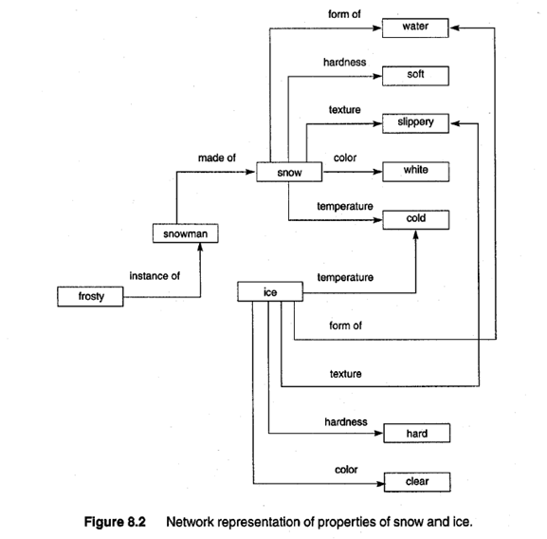
Semantic Networks

Slide 30
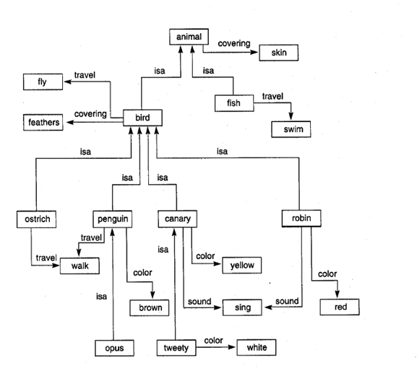
Semantic Networks

Slide 31
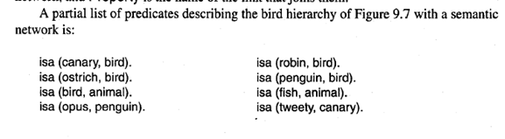
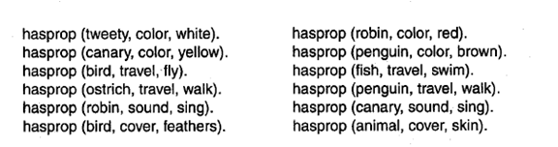
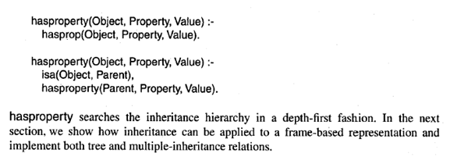
Semantic Networks

Slide 32
Semantic Networks
hasproperty(ostrich, travel,walk). true
hasproperty(canary,color,yellow). true
hasproperty(tweety,sound, sing). true
hasproperty(robin,covering,feather). true
hasproperty(X,sound,sing). robin, cannary, tweety
In semantic nets, to answer questions like is(canary,animal). We need to add one more rule
iSA(Object,Parent):- isa(Object,Parent)
iSA(Object,Parent):- isa(Object, X), iSA(X,Parent)
Assume we have canary birds animals ISA(canary,animal).
iSA(canary,animal) :- isa(canary,bird),iSA(bird, animal) (2)
iSA(bird,animal):- isa(bird,animal) (1)
Assume we have canary beautiful birds birds animals
iSA(canary,animal) :- isa(canary, beautiful-birds),ISA(beutiful-birds, animal) (2)
iSA(beutiful-birds,animal):- isa(beutiful-birds,birds), ISA(birds,animal) (2)
iSA(bird,animal):- isa(bird,animal) (1)

Slide 33
hasprop(tweety, color, white).
hasprop(canary, color, yellow).
hasprop(robin, color, red).
hasprop(penguin, color, brown).
hasprop(canary, sound, sing).
hasprop(robin, sound, sing).
hasprop(ostrich, travel, walk).
hasprop(penguin, travel, walk).
hasprop(fish, travel, swim).
hasprop(bird, travel, fly).
hasprop(bird, cover, feathers).
hasprop(animal, cover, skin).
% Classification hierarchy
isa(tweety, canary).
isa(canary, bird).
isa(robin, bird).
isa(ostrich, bird).
isa(penguin, bird).
isa(bird, animal).
isa(fish, animal).
iSA(Object,Parent) :- isa(Object,Parent).
iSA(Object,Parent) :- isa(Object, X), iSA(X,Parent).
hasproperty(Object, Property, Value) :-
hasprop(Object, Property, Value).
hasproperty(Object, Property, Value) :-
iSA(Object, Parent),
hasproperty(Parent, Property, Value).
SEMANTIC NETWORKS PROGRAM.txt

Slide 34
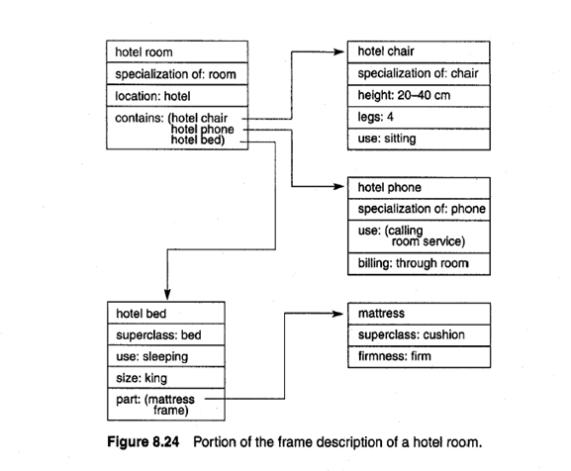
Frames

Slide 35
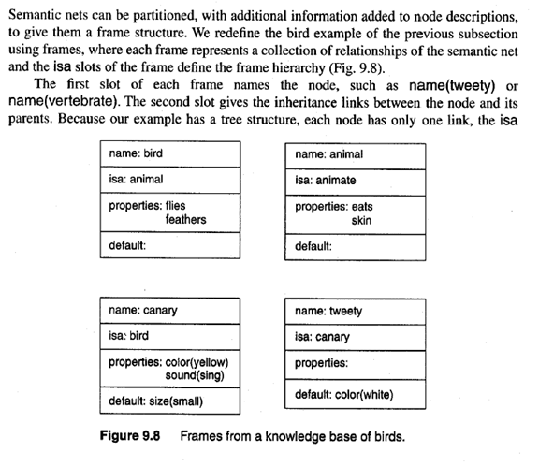
Frames

Slide 36
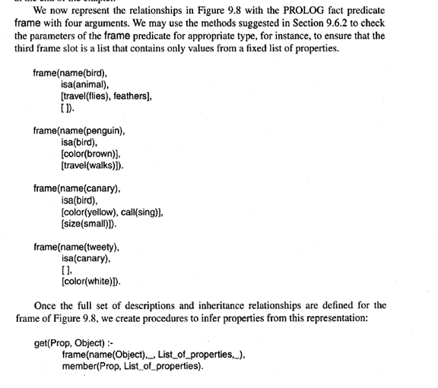
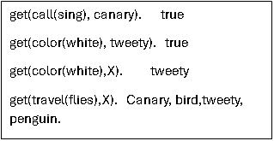
Frames

Slide 37
Frames

Slide 38
Frames

Slide 39
Frames

Slide 40
Frames Program
% Try
% get(travel(flies), opus).
% get(travel(walks),opus).
% get(travel(speed),opus).
% Frame facts
frame(name(bird),
isa([animal]),
[travel(flies), cove(feathers)],
[]).
frame(name(penguin),
isa([bird]),
[color(brown)],
[travel(walks)]).
frame(name(canary),
isa([bird]),
[color(yellow), call(sing)],
[size(small)]).
frame(name(tweety),
isa([canary]),
[],
[color(white)]).
frame(name(opus), isa([penguin,tweety]),[color(black)],[]).
get(Prop, Object):- frame(name(Object),_,L,_), member(Prop,L).
get(Prop, Object):- frame(name(Object),_,_,L), member(Prop,L).
get(Prop, Object):- frame(name(Object),isa(L),_,_), getMultiple(Prop,L).
get(Prop,Object):- frame(name(Object),isa(L),_,_), getMultiple(Prop,L).
% The semicolon (;) acts as "OR"
% The cut (!) stops backtracking if the property is found
% If not found in P, it tries the rest (T)
getMultiple(Prop, [P|T]) :-
get(Prop, P), !;
getMultiple(Prop, T).
%getMultiple(Prop,[P|_]):- get(Prop, P).
%getMultiple(Prop,[_|T]):-getMultiple(Prop,T).
%member(X,[X|_]).
%member(X,[Y|T]):- member(X,T).

Slide 41
Frames Program
FRAMES PROGRAM.txt

Slide 42
Ontology
It defines concepts (classes), relationships, and rules among them.
Example:In a medical domain ontology:-
Classes: Patient, Doctor, Disease, Treatment
Relations:
- hasDisease(Patient, Disease)
- prescribes(Doctor, Treatment)
- treats(Treatment, Disease)
So, you could say: Dr. Smith prescribes Antibiotics to treat Bacterial Infection in John (a patient).

Slide 43
Ontology
An ontology is like a dictionary that defines the terms and relationships within a specific domain. It describes concepts, their properties, and how they relate to one another. These definitions are often represented using a standardized language such as OWL (Web Ontology Language) or RDF (Resource Description Framework).

Slide 44
Ontology
Ontology can be represented in terms of graphs as below:
Nodes (entities/concepts): - Patient - Doctor - Disease - Treatment - Specific instances like John, Dr. Smith, Antibiotics, Bacterial Infection
Edges (relationships):
- John —[hasDisease]→ Bacterial Infection
Dr. Smith —[prescribes]→ Antibiotics
- Antibiotics —[treats]→ Bacterial Infection
- Dr. Smith —[treats]→ John (indirectly through treatment)
This graph shows:-
- Classes (Patient, Doctor, etc.)
Instances (John, Dr. Smith, etc.)
Relations (hasDisease, prescribes, treats)Such a graph can be modeled in tools like Protégé using OWL or RDF, and used in systems that support semantic reasoning.

Slide 45
Ontology
Example: domain of animals:
Class: Animal
Properties: Name, Age, Characteristic
Subclass: Mammal, Bird, Reptile,Fish
Example : In a healthcare ontology, terms like “patient,” “doctor,” and their relationships would be defined.
Example: Creating an ontology for e-commerce product categorization involves defining classes, properties, and relationships that help organize and classify products effectively. Below, is a basic ontology for e-commerce product categorization.

Slide 46
Ontology
Ontology: EcommerceProductOntology Classes: - Product - Category - Brand Properties: - hasCategory - belongsToBrand Instances: - Product instances (Smartphone, Laptop, T-shirt, Sneakers, etc.) - Category instances (Electronics, Clothing, Footwear, etc.) - Brand instances (Apple, Samsung, Nike, Adidas, etc.) Relationships: Each Product instance belongs to a specific Category (hasCategory property). Each Product instance belongs to a specific Brand (belongsToBrand property).

Slide 47
Ontology
Ontology: AnimalOntology Classes: - Animal - Mammal - Bird - Reptile - Characteristic - Behavior Properties: - hasHabitat - hasDiet - hasCharacteristic - hasBehavior Instances: - Animal instances (Lion, Elephant, Penguin, Snake, etc.) - Habitat instances (Savanna, Forest, Ocean, Desert, etc.) - Diet Type instances (Herbivore, Carnivore, Omnivore, etc.) - Characteristic instances (Fur, Feathers, Scales, etc.) - Behavior instances (Nocturnal, Diurnal, Migratory, etc.) Relationships Each Animal instance has a specific habitat (hasHabitat property). Each Animal instance has a specific diet type (hasDiet property). Each Animal instance possesses characteristic features (hasCharacteristic property). Each Animal instance exhibits typical behaviors (hasBehavior property).

Slide 48
Ontology
Utilizing Ontologies in Data Science
1. Data Integration and Interoperability
Ontologies facilitate the integration of diverse data sources. By establishing a common vocabulary and structure, data from various systems can be combined and analyzed more effectively.
Example: Imagine merging data about birds from different databases. An ontology ensures that terms like “wingspan” or “nesting habits” are consistent and compatible across all datasets.
2. Semantic Searching and Retrieval
Ontologies enhance search capabilities by enabling semantic queries. Rather than simple keyword searches, users can query based on the meaning and relationships defined within the ontology.
Example: Searching for “large birds” using an ontology would retrieve data about birds classified as “large” based on defined criteria.

Slide 49
Ontology-Person Ontology
Person ontology

Slide 50
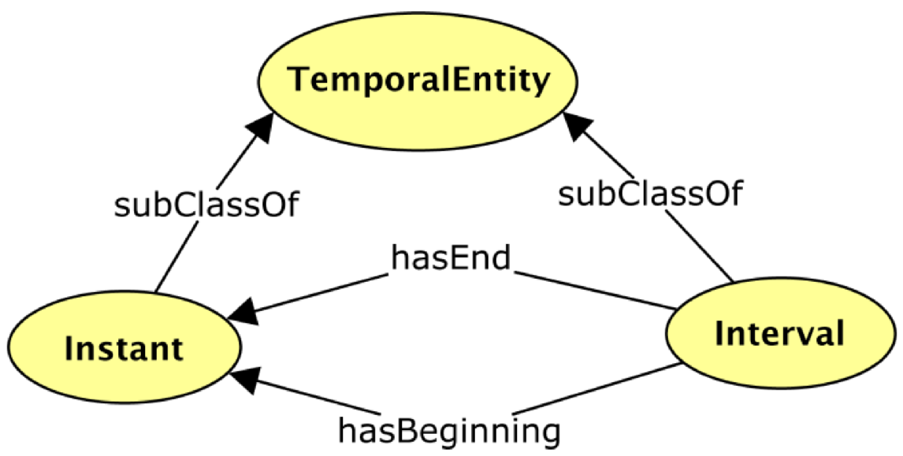
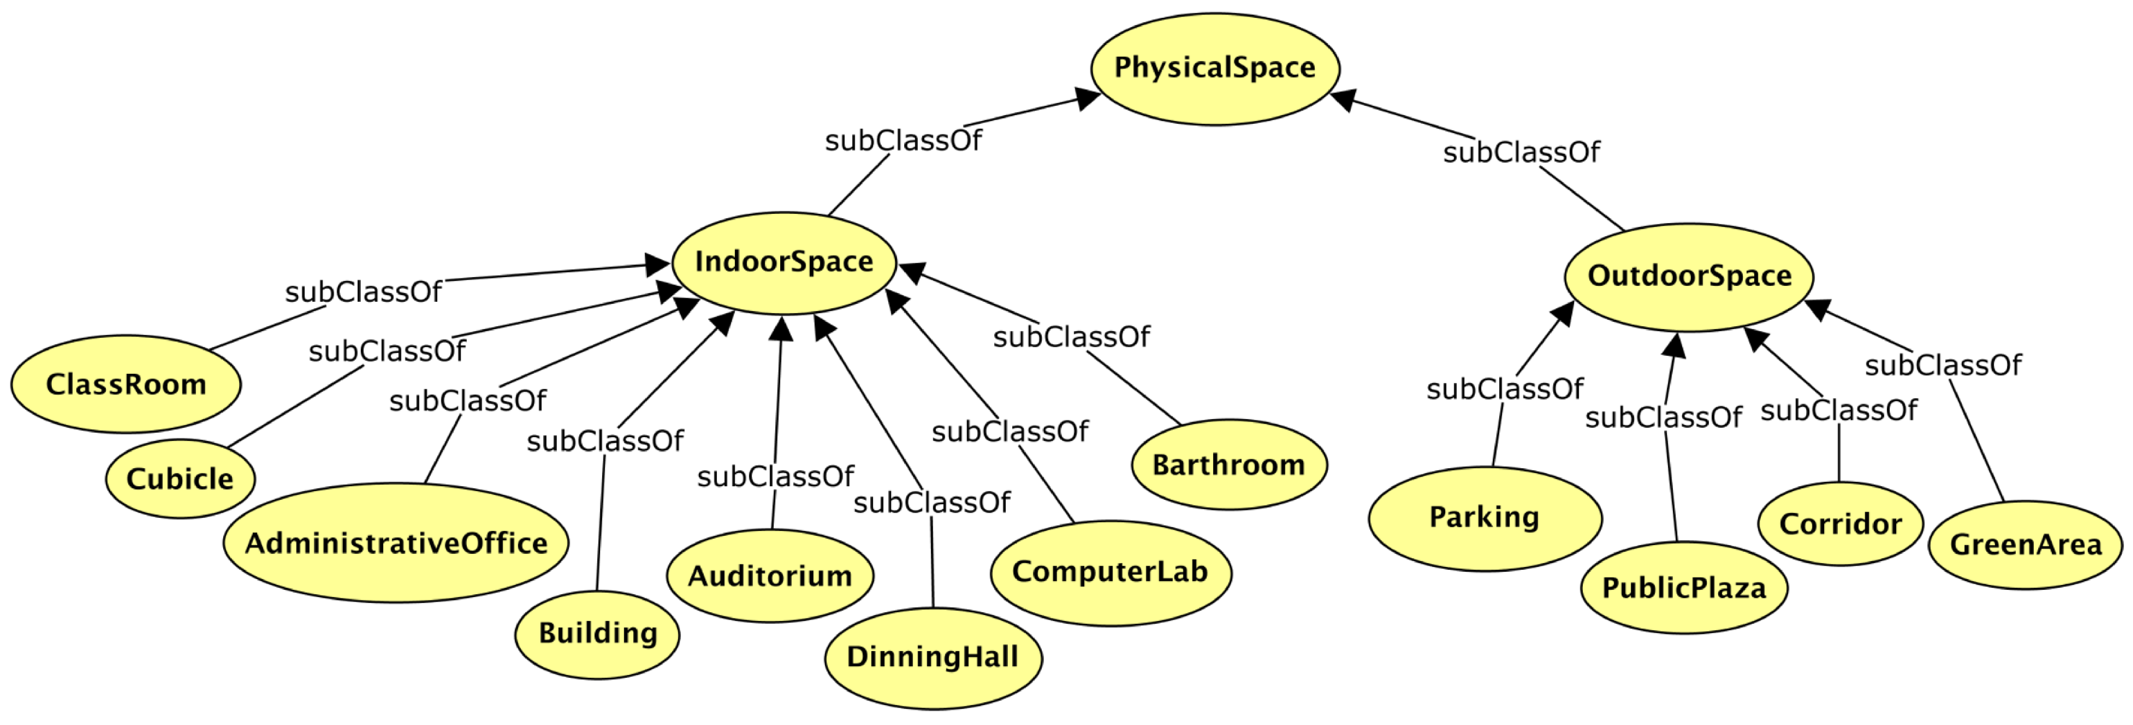
Ontology
Time ontology
Location ontology

Slide 51
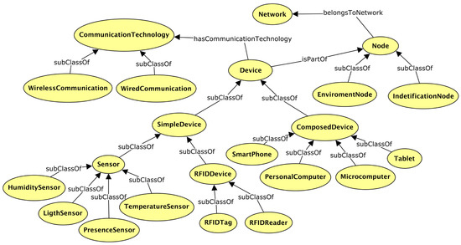
Ontology
Network ontology

Slide 52
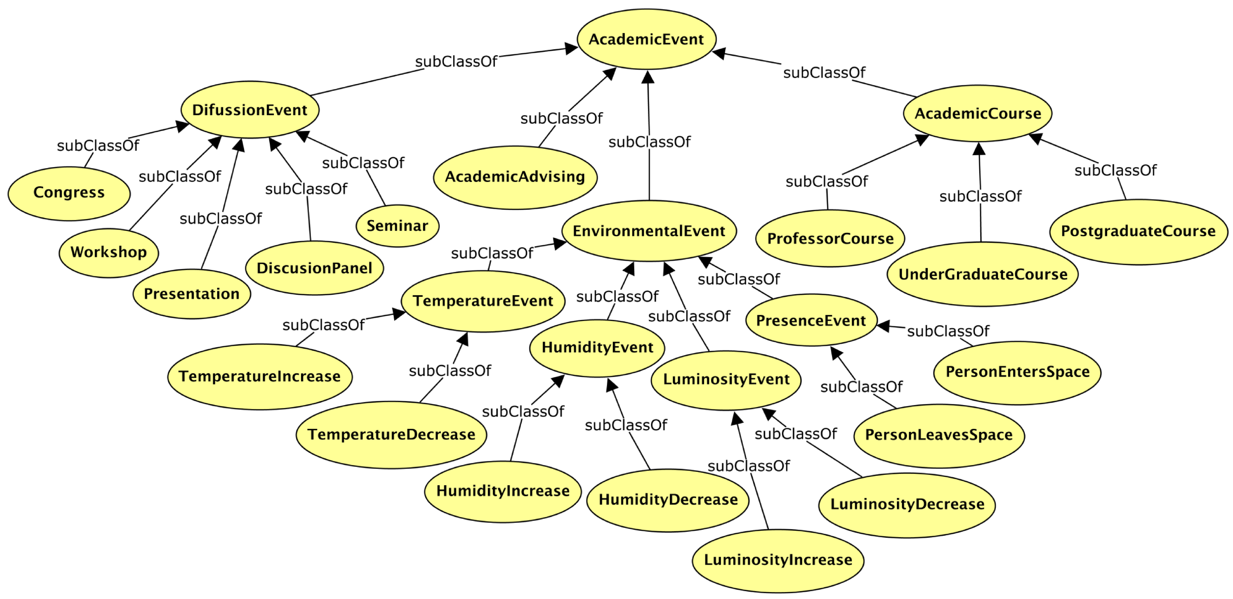
Ontology
Class hierarchy for event ontology.

Slide 53
Ontology
Each line shows:Subject Predicate Object```This reflects:- Class declarations- Subclass relations- Individuals and their types- Properties applied to individualsYou can also serialize this graph to Turtle or RDF/XML formats if needed.
Rdf.txt

Slide 54
Ontology
RDF: Resource Description Framework
- Used to represent information about resources in the web.
- It structures data as triples: (subject, predicate, object). - Example: (Person, hasName, "Alice")-
OWL: Web Ontology Language
- Built on top of RDF.
Used to define rich ontologies
classes, relationships, constraints.
Enables reasoning about data (e.g., if A is a subclass of B, then A inherits B’s properties).
In summary:
RDF is for data representation, - OWL is for defining and reasoning over ontologies.

Slide 55
Ontology Program
rdf.txt

Slide 56
Tools You Can Use Depending on your goal, you can use:
Protégé (GUI-based)- Most popular tool to load, edit, and explore ontologies (.rdf, .owl)- Steps:
1. Install Protégé (from Stanford)
2. File → Open → Load your .rdf file
3. Browse classes, properties, individuals
4. Add rules (e.g., SWRL), reasoners (e.g., HermiT)B.

Slide 57
RDF Libraries in Programming
RDF Libraries in Programming
- Python (RDFlib):
python
from rdflib import Graph
g = Graph()
g.parse("ontology.rdf") # or .owl, .ttl
for subj, pred, obj in g:
print(subj, pred, obj)
Java (Apache Jena):
java Model model = ModelFactory.createDefaultModel();
model.read("ontology.rdf");
model.write(System.out);

Slide 58
RDF Libraries in Programming
Prolog (SWI-Prolog):
:- use_module(library(semweb/rdf_db)).
:- rdf_load('ontology.rdf’).
?- rdf(S, P, O).
C. SPARQL Queries-
Use SPARQL to query RDF data:
```sparql
SELECT ?subject ?object
WHERE { ?subject <http://example.org/hasPart> ?object . } ```

Slide 59
Ontology
The RDF triples output by the ontology program can be used in many semantic web and AI applications. Here's how you can use them:
Storing in a Triple Store- Use tools like Apache Jena Fuseki or Blazegraph to store RDF triples.- You can then query them using SPARQL.- Example use case: educational platform querying relationships like who teaches what
Using in a Knowledge Graph- The output can be integrated into a knowledge graph to connect data semantically.- Applications: chatbots, recommendation systems, semantic search.
3. Integrating with Web Apps- Convert RDF to formats like JSON-LD for use in web applications.- Useful in structured data for SEO, dynamic content rendering, etc.
4. Reasoning and Inference- Use OWL reasoners (like Pellet, HermiT) to infer new knowledge.- For example, infer that Alice is a Person because she is a Professor, and Professor is a subclass of Person.5. Export/Serialization- Save the RDF graph in formats like Turtle (.ttl), RDF/XML, or JSON-LD.- These can be shared, published, or reused by other semantic web tools.

